Slide 1
Lloyds
HOME DEPOT KAGGLE CHALLENGE

Slide 2
The Challenge
From installing a new ceiling fan to remodeling an entire kitchen, with the click of a mouse or tap of the screen, customers expect the correct results to their queries – quickly. Speed, accuracy and delivering a frictionless customer experience are essential.
In this competition, Home Depot is asking Kagglers to help them improve their customers' shopping experience by developing a model that can accurately predict the relevance of search results.
Search relevancy is an implicit measure Home Depot uses to gauge how quickly they can get customers to the right products. Currently, human raters evaluate the impact of potential changes to their search algorithms, which is a slow and subjective process. By removing or minimizing human input in search relevance evaluation, Home Depot hopes to increase the number of iterations their team can perform on the current search algorithms.

Slide 3
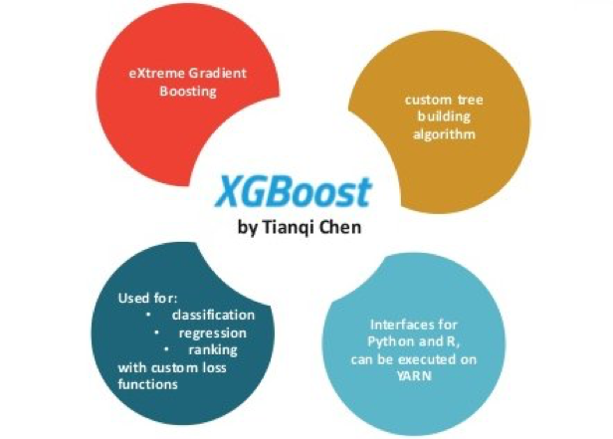
The “linear” model
Number of Words (search term)
Number of Words Matching Title
Normal and contained inside word
Stemming
Number of Words Matching Description
Normal and contained inside word
Stemming (Porter)
Notes:
Boosting is based on weak learners (high bias, low variance). In terms of decision trees, weak learners are shallow trees, sometimes even as small as decision stumps (trees with two leaves). The boosting continue to update the weights of training set based on previous weaker learner to improve the importance of data which are classified wrongly.

Slide 4
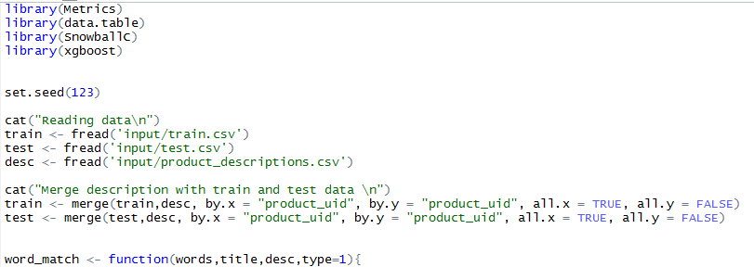

The code
Forked from Xgb Beat the Benchmark by APS (Kaggle)
For download here: https://github.com/nfaustino/HomeDepot

Slide 5
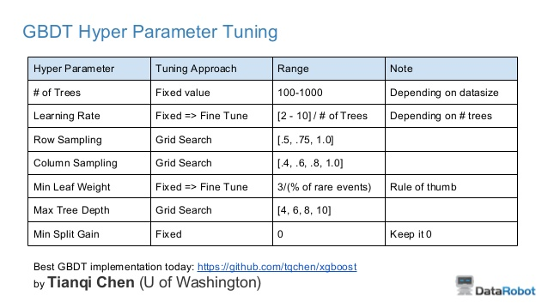
Tuning parameters
For this exercise, the tuning parameters followed the rules of thumb by XGBoost creator
With more time, hyper parameter cross-validation could improve results

Slide 6
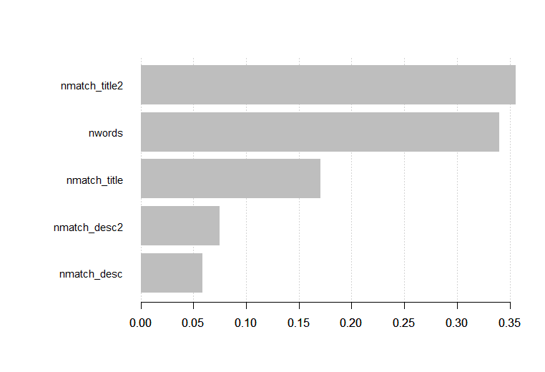
Importance of Variables
Number of matching words with title using stemming is the most important predictor
The number of words on the search term is also useful to predict relevance

Slide 7
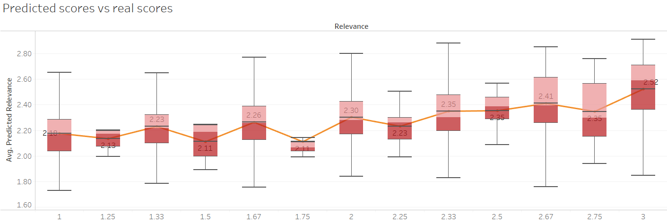
Visualising results on Tableau
Full drill down capabilities
https://public.tableau.com/profile/nuno.faustino#!/vizhome/Explore_5/Dashboard1

Slide 8
Additional techniques
Use product attributes from the dataset provided
Acronym normalization and tagging – acronyms can be specified as “I.B.M.” or “IBM” so these should be tagged and normalized.
Lemmatization - reduces word variations to simpler forms that may help increase the coverage of NLP utilities.
Phrase extraction – extracts sequences of tokens (phrases) that have a strong meaning which is independent of the words when treated separately. These sequences should be treated as a single unit when doing NLP.

Slide 9
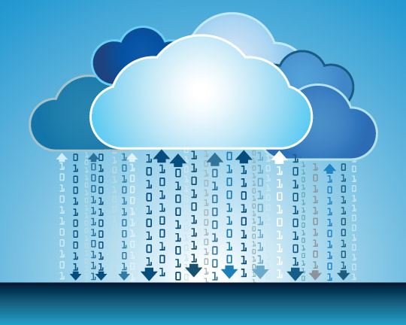
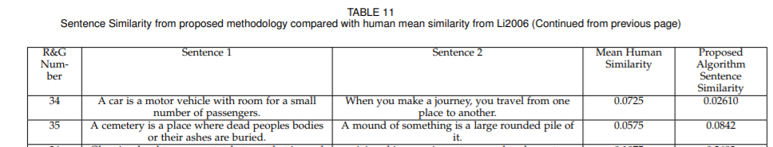
Alternative methodologies (NLP)
Unsupervised and/or deep learning
Google Cloud API
Semantic Networks
Notes:
https://arxiv.org/pdf/1802.05667.pdf

Slide 10
Thank you!

